Slide 1
Storage and File Structure
Chapter 11

Slide 2
Introduction
Requirements
ER- Model
Relation Model
Normalization
File Structure

Slide 3
Classification of Physical Storage Media
Speed with which data can be accessed
Cost per unit of data
Reliability
data loss on power failure or system crash
physical failure of the storage device
Can differentiate storage into:
volatile storage: loses contents when power is switched off
non-volatile storage:
Contents persist even when power is switched off.
Includes secondary and tertiary storage, as well as batter-backed up main-memory.

Slide 4
Physical Storage Media
Cache – fastest and most costly form of storage; volatile; managed by the computer system hardware.
Main memory:
fast access (10s to 100s of nanoseconds; 1 nanosecond = 10^{–9} seconds)
generally too small (or too expensive) to store the entire database
capacities of up to a few Gigabytes widely used currently
Capacities have gone up and per-byte costs have decreased steadily and rapidly (roughly factor of 2 every 2 to 3 years)
Volatile — contents of main memory are usually lost if a power failure or system crash occurs.

Slide 5
Physical Storage Media
Flash memory
Data survives power failure
Data can be written at a location only once, but location can be erased and written to again
Can support only a limited number of write/erase cycles.
Erasing of memory has to be done to an entire bank of memory
Reads are roughly as fast as main memory
But writes are slow (few microseconds), erase is slower
Cost per unit of storage roughly similar to main memory
Widely used in embedded devices such as digital cameras
also known as EEPROM (Electrically Erasable Programmable Read-Only Memory)

Slide 6
Physical Storage Media
Magnetic-disk
Data is stored on spinning disk, and read/written magnetically
Primary medium for the long-term storage of data; typically stores entire database.
Data must be moved from disk to main memory for access, and written back for storage
Much slower access than main memory
direct-access – possible to read data on disk in any order, unlike magnetic tape
Hard disks vs floppy disks
Capacities range up to roughly 100-500 GB currently
Much larger capacity and cost/byte than main memory/flash memory
Growing constantly and rapidly with technology improvements (factor of 2 to 3 every 2 years)
Survives power failures and system crashes
disk failure can destroy data, but is very rare

Slide 7
Physical Storage Media
Optical storage
non-volatile, data is read optically from a spinning disk using a laser
CD-ROM (640 MB) and DVD (4.7 to 17 GB) most popular forms
Write-one, read-many (WORM) optical disks used for archival storage (CD-R and DVD-R)
Multiple write versions also available (CD-RW, DVD-RW, and DVD-RAM)
Reads and writes are slower than with magnetic disk
Juke-box systems, with large numbers of removable disks, a few drives, and a mechanism for automatic loading/unloading of disks available for storing large volumes of data

Slide 8
Physical Storage Media
Tape storage
non-volatile, used primarily for backup (to recover from disk failure), and for archival data
sequential-access – much slower than disk
very high capacity (40 to 300 GB tapes available)
tape can be removed from drive ⇒ storage costs much cheaper than disk, but drives are expensive
Tape jukeboxes available for storing massive amounts of data
hundreds of terabytes (1 terabyte = 10⁹ bytes) to even a petabyte (1 petabyte = 10¹² bytes)

Slide 9
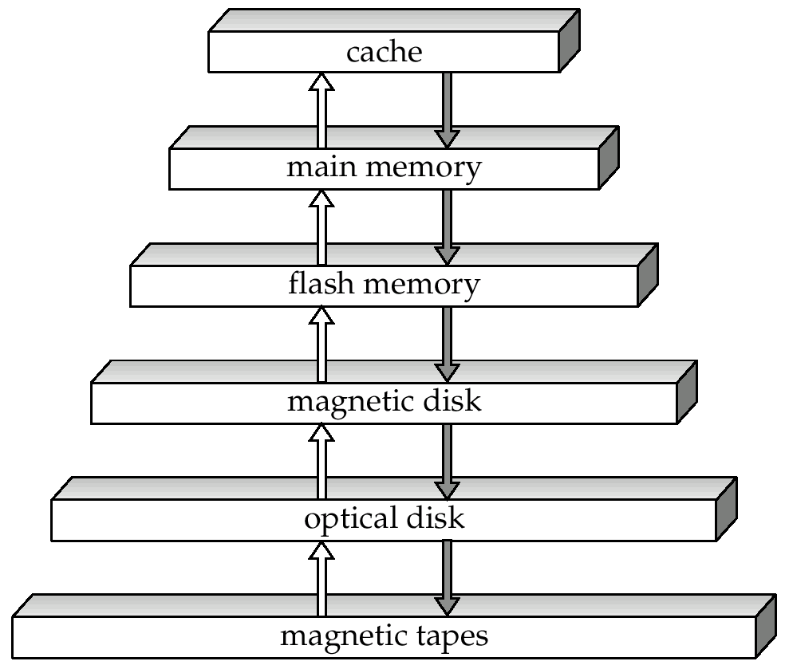
Storage Hierarchy

Slide 10
Storage Hierarchy
primary storage: Fastest media but volatile (cache, main memory).
secondary storage: next level in hierarchy, non-volatile, moderately fast access time
also called on-line storage
E.g. flash memory, magnetic disks
tertiary storage: lowest level in hierarchy, non-volatile, slow access time
also called off-line storage
E.g. magnetic tape, optical storage

Slide 11
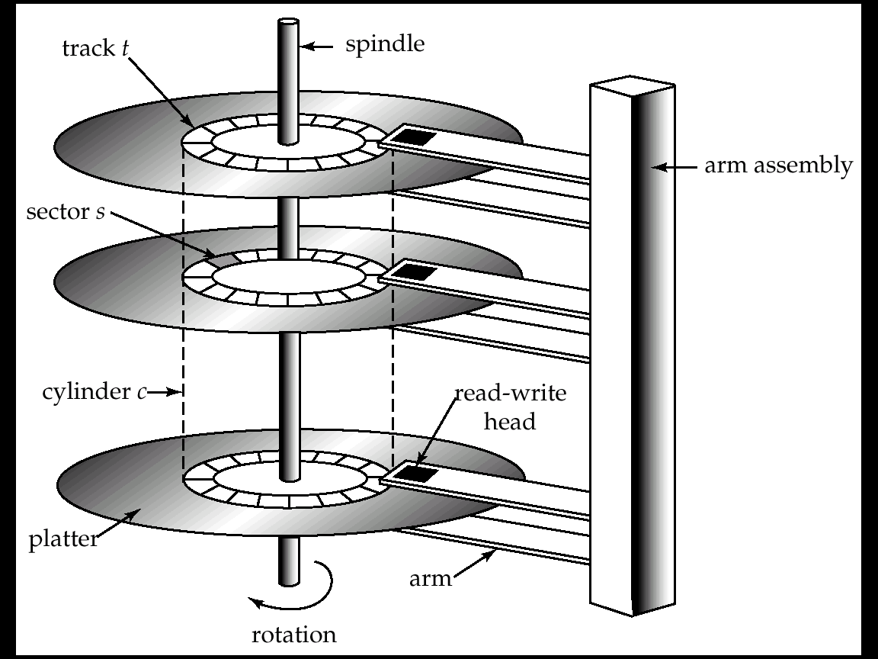
Magnetic Hard disk Mechanism

Slide 12
Magnetic Disks
Read-write head
Positioned very close to the platter surface (almost touching it)
Reads or writes magnetically encoded information.
Surface of platter divided into circular tracks
Over 16,000 tracks per platter on typical hard disks
Each track is divided into sectors.
A sector is the smallest unit of data that can be read or written.
Sector size typically 512 bytes
Typical sectors per track: 200 (on inner tracks) to 400 (on outer tracks)
To read/write a sector
disk arm swings to position head on right track
platter spins continually; data is read/written as sector passes under head
Head-disk assemblies
multiple disk platters on a single spindle (typically 2 to 4)
one head per platter, mounted on a common arm.
Cylinder i consists of i^{th} track of all the platters

Slide 13
Magnetic Disks
Earlier generation disks were susceptible to head-crashes
Surface of earlier generation disks had metal-oxide coatings which would disintegrate on head crash and damage all data on disk
Current generation disks are less susceptible to such disastrous failures, although individual sectors may get corrupted
Disk controller – interfaces between the computer system and the disk drive hardware.
accepts high-level commands to read or write a sector
initiates actions such as moving the disk arm to the right track and actually reading or writing the data
Computes and attaches checksums to each sector to verify that data is read back correctly
If data is corrupted, with very high probability stored checksum won’t match recomputed checksum
Ensures successful writing by reading back sector after writing it
Performs remapping of bad sectors

Slide 14
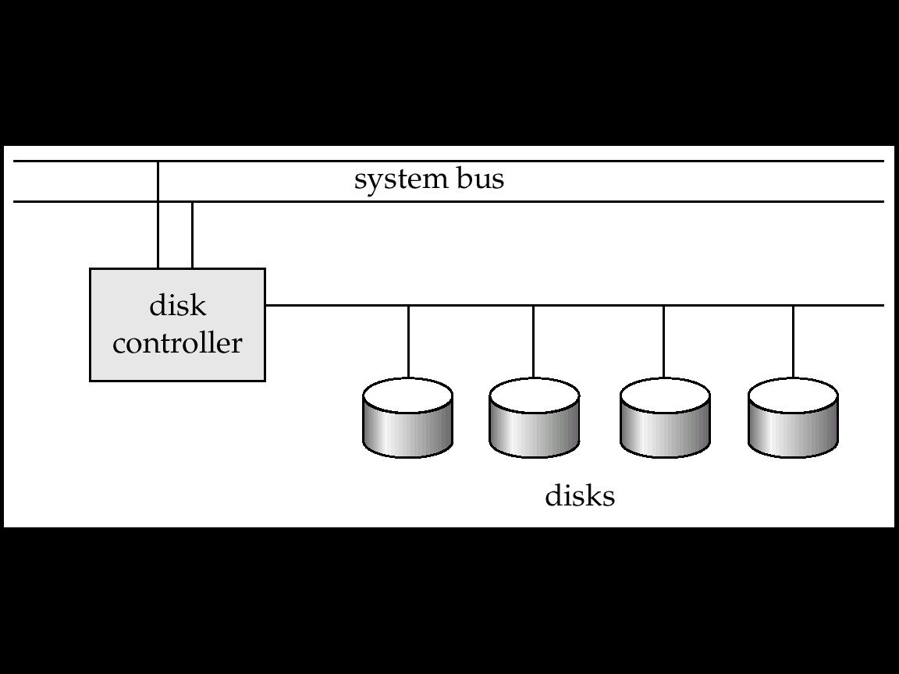
Magnetic Disks
Multiple disks connected to a computer system through a controller
Controllers functionality (checksum, bad sector remapping) often carried out by individual disks; reduces load on controller
Disk interface standards families
ATA (AT adaptor) range of standards
SCSI (Small Computer System Interconnect) range of standards
Several variants of each standard (different speeds and capabilities

Slide 15
Performance Measure of Disks
Access time – the time it takes from when a read or write request is issued to when data transfer begins. Consists of:
Seek time – time it takes to reposition the arm over the correct track.
Average seek time is 1/2 the worst case seek time.
Would be 1/3 if all tracks had the same number of sectors, and we ignore the time to start and stop arm movement
4 to 10 milliseconds on typical disks
Rotational latency – time it takes for the sector to be accessed to appear under the head.
Average latency is 1/2 of the worst case latency.
4 to 11 milliseconds on typical disks (5400 to 15000 r.p.m.)

Slide 16
Performance Measure of Disks
Data-transfer rate – the rate at which data can be retrieved from or stored to the disk.
4 to 8 MB per second is typical
Multiple disks may share a controller, so rate that controller can handle is also important
E.g. ATA-5: 66 MB/second, SCSI-3: 40 MB/s
Fiber Channel: 256 MB/s
Mean time to failure (MTTF) – the average time the disk is expected to run continuously without any failure.
Typically 3 to 5 years
MTTF decreases as disk ages

Slide 17
RAID
RAID: Redundant Arrays of Independent Disks
disk organization techniques that manage a large numbers of disks, providing a view of a single disk of
high capacity and high speed by using multiple disks in parallel, and
high reliability by storing data redundantly, so that data can be recovered even if a disk fails
The chance that some disk out of a set of N disks will fail is much higher than the chance that a specific single disk will fail.
E.g., a system with 100 disks, each with MTTF of 100,000 hours (approx. 11 years), will have a system MTTF of 1000 hours (approx. 41 days)
Techniques for using redundancy to avoid data loss are critical with large numbers of disks
Originally a cost-effective alternative to large, expensive disks
I in RAID originally stood for ``inexpensive’’
Today RAIDs are used for their higher reliability and bandwidth.
The “I” is interpreted as independent

Slide 18
Improvement of reliability via RAID
Redundancy – store extra information that can be used to rebuild information lost in a disk failure
E.g., Mirroring (or shadowing)
Duplicate every disk. Logical disk consists of two physical disks.
Every write is carried out on both disks
Reads can take place from either disk
If one disk in a pair fails, data still available in the other
Data loss would occur only if a disk fails, and its mirror disk also fails before the system is repaired
Probability of combined event is very small
Except for dependent failure modes such as fire or building collapse or electrical power surges
Mean time to data loss depends on mean time to failure, and mean time to repair
E.g. MTTF of 100,000 hours, mean time to repair of 10 hours gives mean time to data loss of 500*10⁶ hours (or 57,000 years) for a mirrored pair of disks (ignoring dependent failure modes)

Slide 19
Storage Access
A database file is partitioned into fixed-length storage units called blocks. Blocks are units of both storage allocation and data transfer.
Database system seeks to minimize the number of block transfers between the disk and memory. We can reduce the number of disk accesses by keeping as many blocks as possible in main memory.
Buffer – portion of main memory available to store copies of disk blocks.
Buffer manager – subsystem responsible for allocating buffer space in main memory.

Slide 20
Buffer Manager
Programs call on the buffer manager when they need a block from disk.
If the block is already in the buffer, the requesting program is given the address of the block in main memory
If the block is not in the buffer,
the buffer manager allocates space in the buffer for the block, replacing (throwing out) some other block, if required, to make space for the new block.
The block that is thrown out is written back to disk only if it was modified since the most recent time that it was written to/fetched from the disk.
Once space is allocated in the buffer, the buffer manager reads the block from the disk to the buffer, and passes the address of the block in main memory to requester.

Slide 21
Buffer-Replacement Policies
Most operating systems replace the block least recently used (LRU strategy)
Idea behind LRU – use past pattern of block references as a predictor of future references
Queries have well-defined access patterns (such as sequential scans), and a database system can use the information in a user’s query to predict future references
LRU can be a bad strategy for certain access patterns involving repeated scans of data
e.g. when computing the join of 2 relations r and s by a nested loops for each tuple tr of r do for each tuple ts of s do if the tuples tr and ts match …
Mixed strategy with hints on replacement strategy provided by the query optimizer is preferable

Slide 22
Buffer-Replacement Policies
Pinned block – memory block that is not allowed to be written back to disk.
Toss-immediate strategy – frees the space occupied by a block as soon as the final tuple of that block has been processed
Most recently used (MRU) strategy – system must pin the block currently being processed. After the final tuple of that block has been processed, the block is unpinned, and it becomes the most recently used block.
Buffer manager can use statistical information regarding the probability that a request will reference a particular relation
E.g., the data dictionary is frequently accessed.
Heuristic: keep data-dictionary blocks in main memory buffer
Buffer managers also support forced output of blocks for the purpose of recovery

Slide 23
File Organization
The database is stored as a collection of files. Each file is a sequence of records. A record is a sequence of fields.
One approach:
assume record size is fixed
each file has records of one particular type only
different files are used for different relations

Slide 24
File Structure
Files are the data structures, which are stored in different ways
Contiguous Allocation
Linked Allocation (Non Contiguous)
Index (I node)
1
2
3
4
5
6
7
8
9
10
11
12
13
14
15
16

Slide 25
File Structure
Files are the data structures, which are stored in different ways
Contiguous Allocation
Linked Allocation (Non Contiguous)
Index (I node)
1
2
3
4
5
6
7
8
9
10
11
12
13
14
15
16

Slide 26
File Structure
Files are the data structures, which are stored in different ways
Contiguous Allocation
Linked Allocation (Non Contiguous)
Index (I node)
1
2
3
4
5
6
7
8
9
10
11
12
13
14
15
16

Slide 27
File Structure
Index Block
Files are the data structures, which are stored in different ways
Contiguous Allocation
Linked Allocation (Non Contiguous)
Index (I node)
1
2
3
4
5
6
7
8
9
10
11
12
13
14
15
16

Slide 28
File Structure
Sorted File Unsorted File
1. Can be sorted according to 1. Random order, any record
any one attribute(search key) can be placed anywhere
2. Searching is fast (binary) 2. Searching is slow(linear)
O(log n) O(n)
3. Insertion & deletion will be 3. Insertion & deletion will difficult be easy
Need to swap all records.

Slide 29
Spanned and UnSpanned Mapping
R1
R2
R3
R4
R5
R6
R7
R8
R9
R10 24Kb
76KB
R12
R13
R14
Block Size = 1024 KB
Table => 14 records
1 Record = 100KB
B1
B2
Spanned Mapping :- No space wasted
Unspanned Mapping :- Whole record should be stored only if it is stored completely

Slide 30
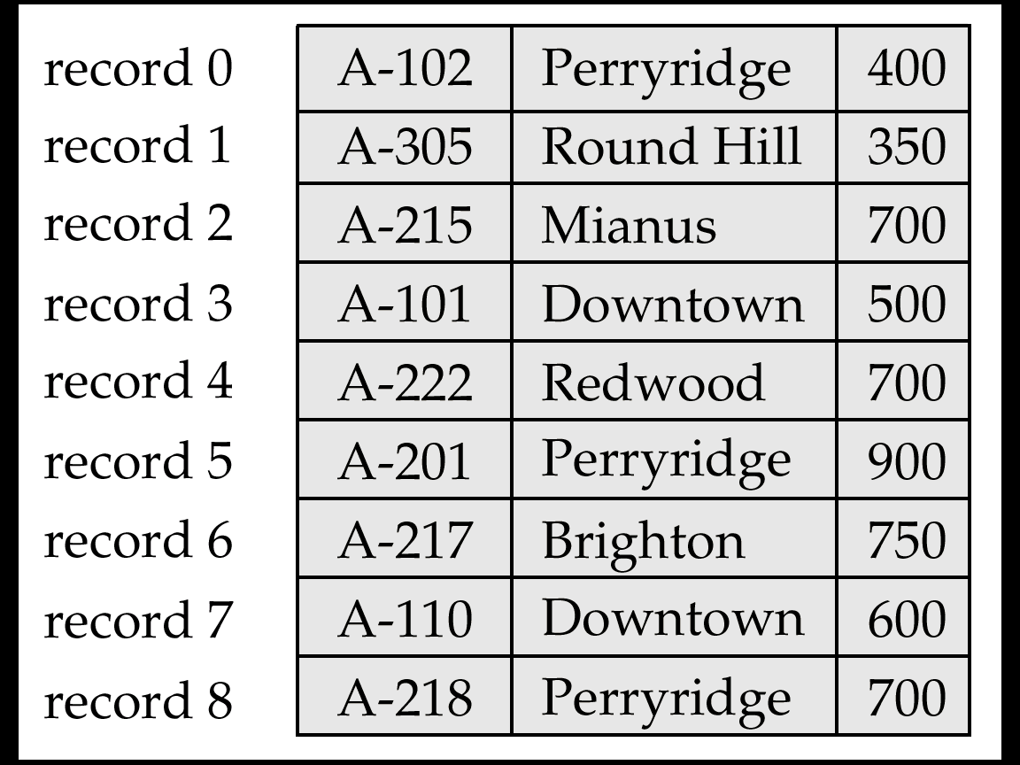
Fixed-Length Records
Simple approach:
Store record i starting from byte n * (i – 1), where n is the size of each record.
Record access is simple but records may cross blocks
Modification: do not allow records to cross block boundaries
Deletion of record I: alternatives:
move records i + 1, . . ., n to i, . . . , n – 1
move record n to i
do not move records, but link all free records on a free list

Slide 31
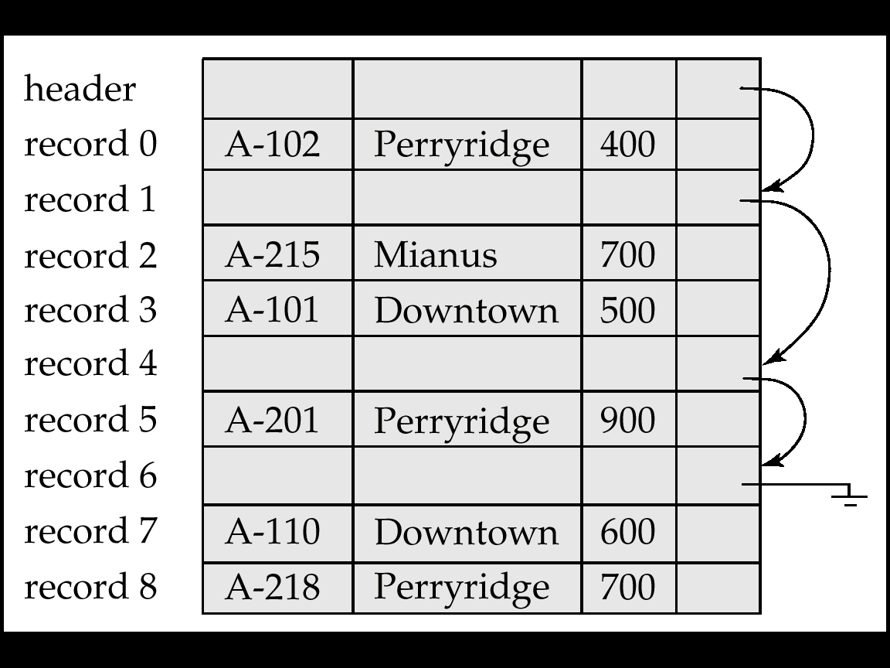
Free Lists
Store the address of the first deleted record in the file header.
Use this first record to store the address of the second deleted record, and so on
Can think of these stored addresses as pointers since they “point” to the location of a record.
More space efficient
representation: reuse space
for normal attributes of free
records to store pointers.
(No pointers stored in in-use
records.)

Slide 32
Variable-Length Records
Variable-length records arise in database systems in several ways:
Storage of multiple record types in a file.
Record types that allow variable lengths for one or more fields.
Record types that allow repeating fields (used in some older data models).
Byte string representation
Attach an end-of-record (⊥) control character to the end of each record
Difficulty with deletion
Difficulty with growth

Slide 33
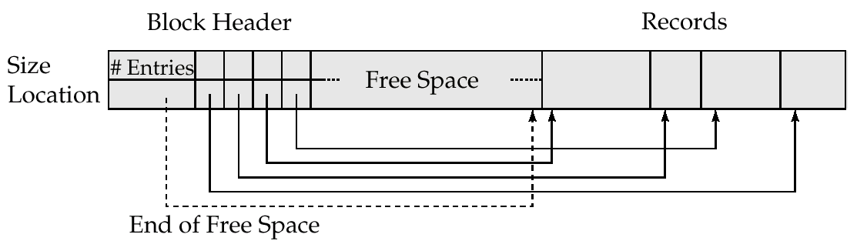
Variable-Length Records –Slotted page structure
Slotted page header contains:
number of record entries
end of free space in the block
location and size of each record
Records can be moved around within a page to keep them contiguous with no empty space between them; entry in the header must be updated.
Pointers should not point directly to record — instead they should point to the entry for the record in header.

Slide 34
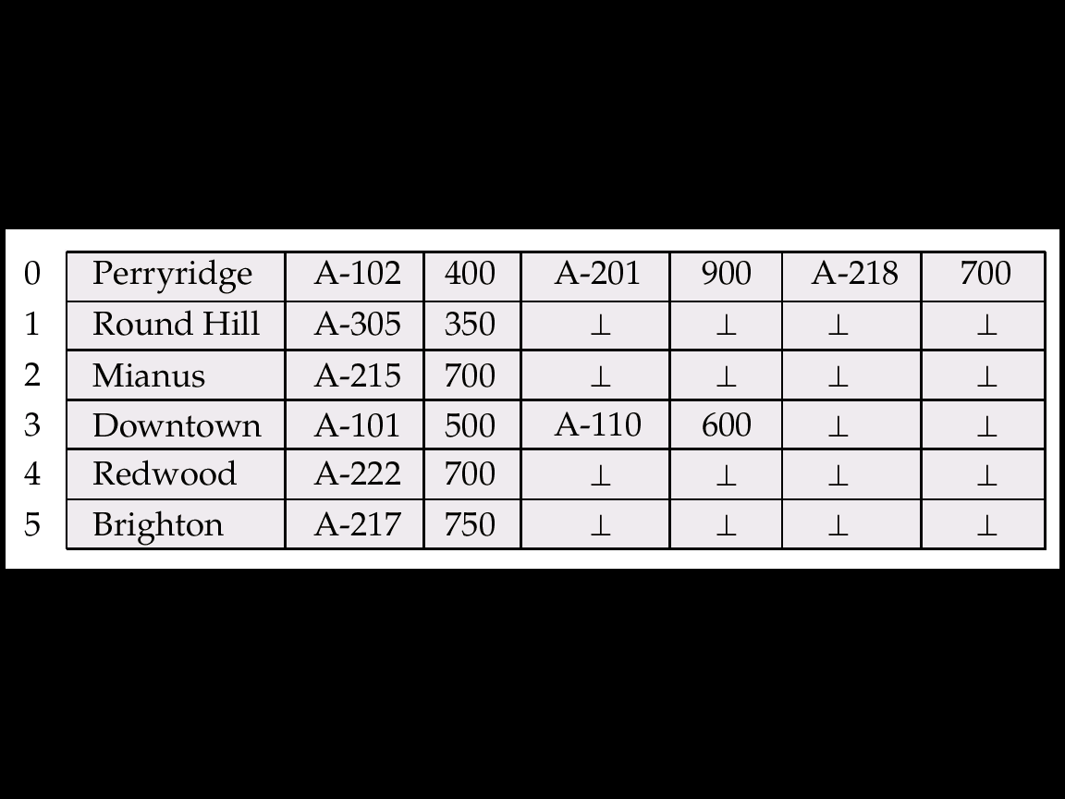
Variable-Length Records
Fixed-length representation:
reserved space
pointers
Reserved space – can use fixed-length records of a known maximum length;
unused space in shorter records filled with a null or end-of-record symbol.

Slide 35
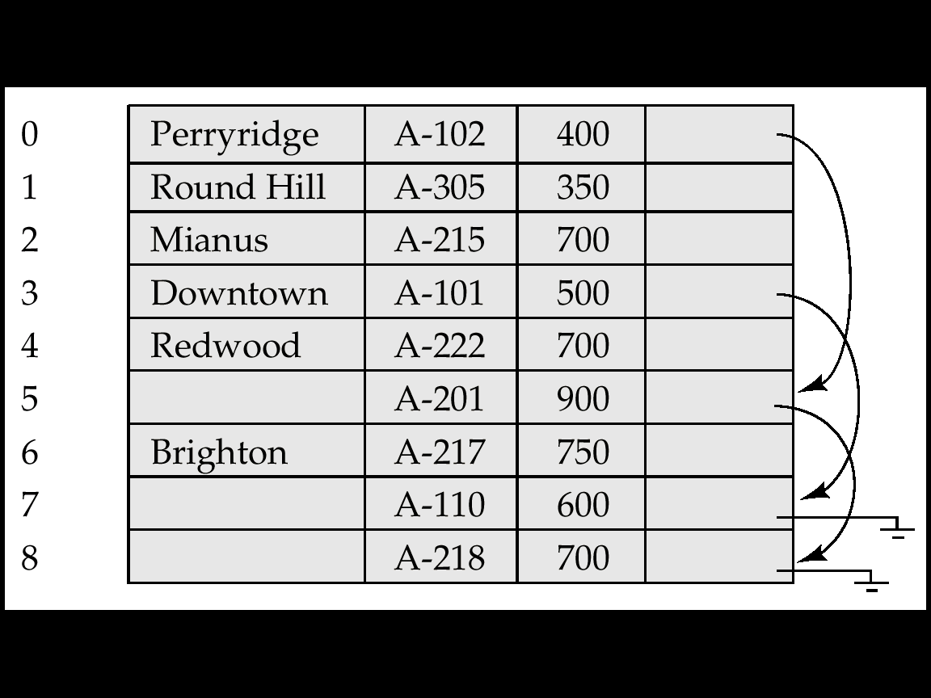
Pointer Methods
Pointer method
A variable-length record is represented by a list of fixed-length records, chained together via pointers.
Can be used even if the maximum record length is not known

Slide 36
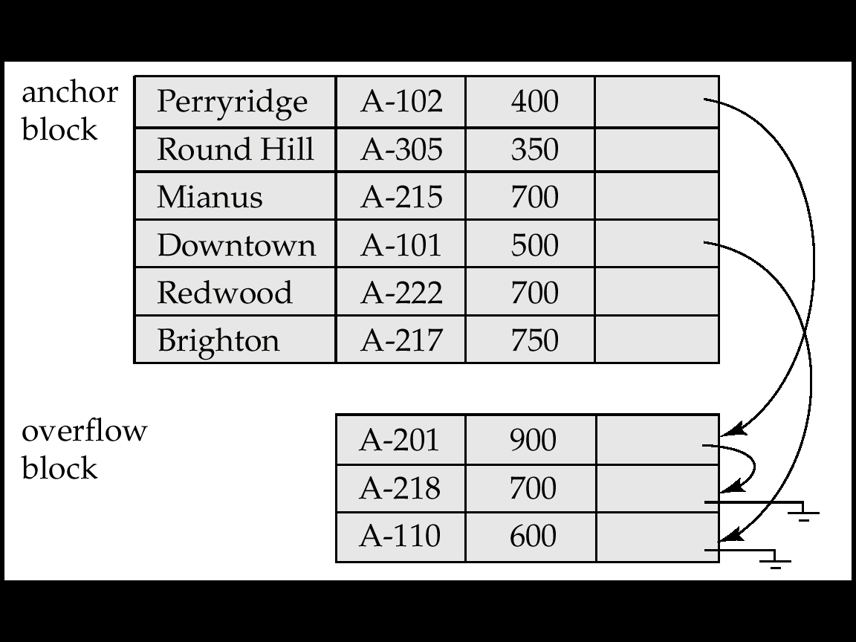
Pointer Methods
Disadvantage to pointer structure; space is wasted in all records except the first in a chain.
Solution is to allow two kinds of block in file:
Anchor block – contains the first records of chain
Overflow block – contains records other than those that are the first records of chains.

Slide 37
Organization of Records in Files
Heap – a record can be placed anywhere in the file where there is space
Sequential – store records in sequential order, based on the value of the search key of each record
Hashing – a hash function computed on some attribute of each record; the result specifies in which block of the file the record should be placed
Records of each relation may be stored in a separate file. In a clustering file organization records of several different relations can be stored in the same file
Motivation: store related records on the same block to minimize I/O

Slide 38
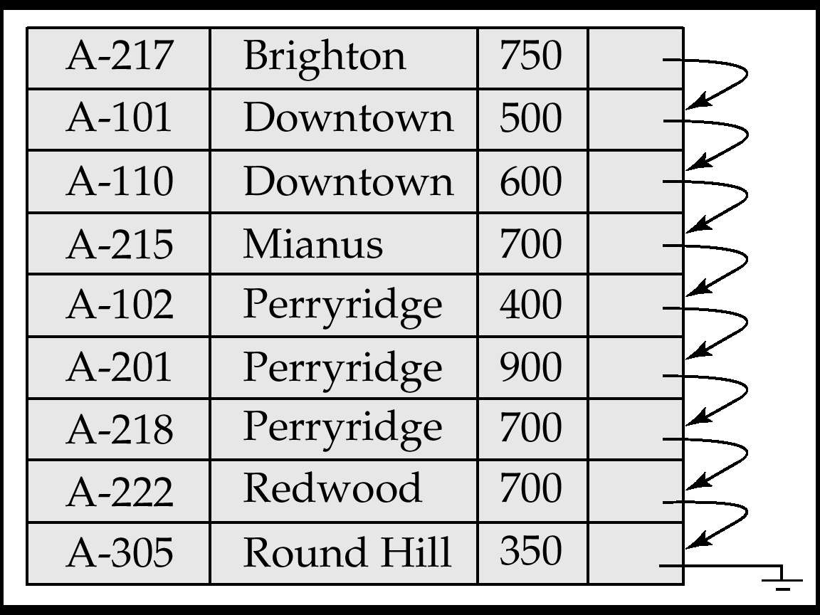
Sequential File Organization
Suitable for applications that require sequential processing of the entire file
The records in the file are ordered by a search-key

Slide 39
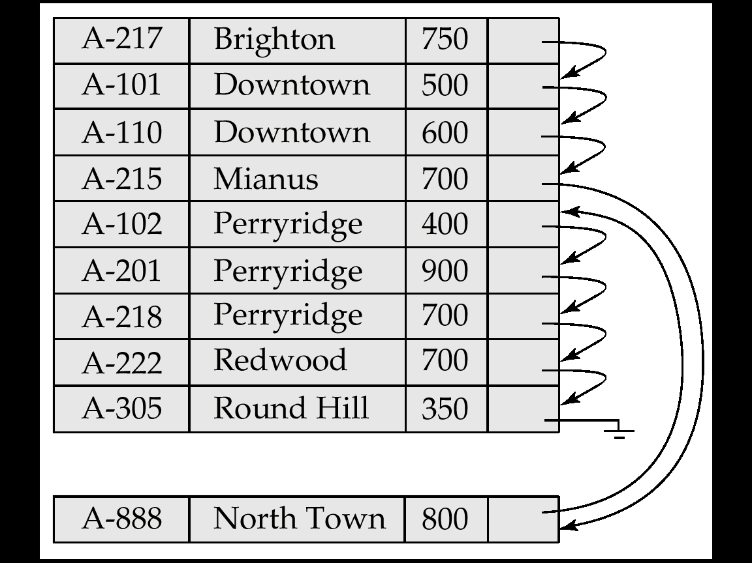
Sequential File Organization (Cont.)
Deletion – use pointer chains
Insertion –locate the position where the record is to be inserted
if there is free space insert there
if no free space, insert the record in an overflow block
In either case, pointer chain must be updated
Need to reorganize the file from time to time to restore sequential order

Slide 40
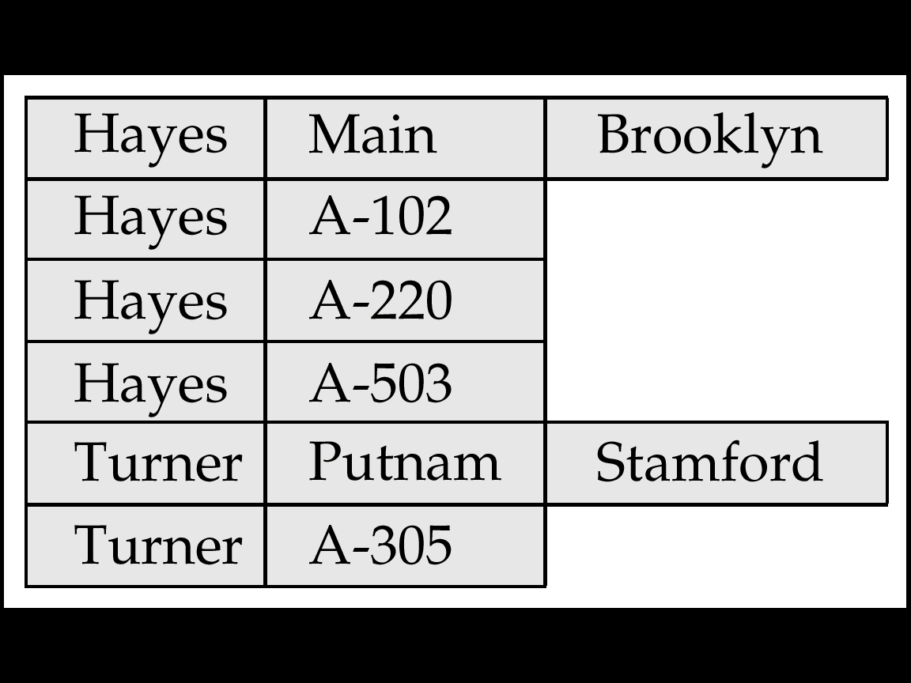
Clustering File Organization
Simple file structure stores each relation in a separate file
Can instead store several relations in one file using a clustering file organization
E.g., clustering organization of customer and depositor:
good for queries involving depositor join customer, and for queries involving one single customer and his accounts
bad for queries involving only customer
results in variable size records

Slide 41
Data Dictionary Storage
Data dictionary (also called system catalog) stores metadata: that is, data about data, such as
Information about relations
names of relations
names and types of attributes of each relation
names and definitions of views
integrity constraints
User and accounting information, including passwords
Statistical and descriptive data
number of tuples in each relation
Physical file organization information
How relation is stored (sequential/hash/…)
Physical location of relation
operating system file name or
disk addresses of blocks containing records of the relation

Slide 42
Data Dictionary Storage
Catalog structure: can use either
specialized data structures designed for efficient access
a set of relations, with existing system features used to ensure efficient access
The latter alternative is usually preferred
A possible catalog representation:
Relation-metadata = (relation-name, number-of-attributes, storage-organization, location)
Attribute-metadata = (attribute-name, relation-name, domain-type, position, length)
User-metadata = (user-name, encrypted-password, group)
Index-metadata = (index-name, relation-name, index-type,
index-attributes)
View-metadata = (view-name, definition)

Slide 43
Large Objects
Large objects : binary large objects (blobs) and character large objects (clobs)
Examples include:
text documents
graphical data such as images and computer aided designs audio and video data
Large objects may need to be stored in a contiguous sequence of bytes when brought into memory.
If an object is bigger than a page, contiguous pages of the buffer pool must be allocated to store it.
May be preferable to disallow direct access to data, and only allow access through a file-system-like API, to remove need for contiguous storage.

Slide 44
Modifying Large Objects
If the application requires insert/delete of bytes from specified regions of an object:
B⁺-tree file organization can be modified to represent large objects
Each leaf page of the tree stores between half and 1 page worth of data from the object
Special-purpose application programs outside the database are used to manipulate large objects:
Text data treated as a byte string manipulated by editors and formatters.
Graphical data and audio/video data is typically created and displayed by separate application
checkout/checkin method for concurrency control and creation of versions

